Slide 1

UX Analysis of Uber Eats Mobile App
Team: Sappers
Team Member Names:
Chaithra Lakshmi Sathyanarayana
Christina Perry
Namrata Chandrakant Kasar
Shivam Tyagi

Slide 2
Feature Evaluation
Good Assessment
Easy switch between Delivery and Pickup options.
Categorised lists of food and restaurants.
Quick options for payment, tip and promo code.
Option to change the time of delivery as per choice.
Well placed promotions and schemes for customers.
Accessible issue reporting and feedback options.
Accessible guides and documentation.

Slide 3
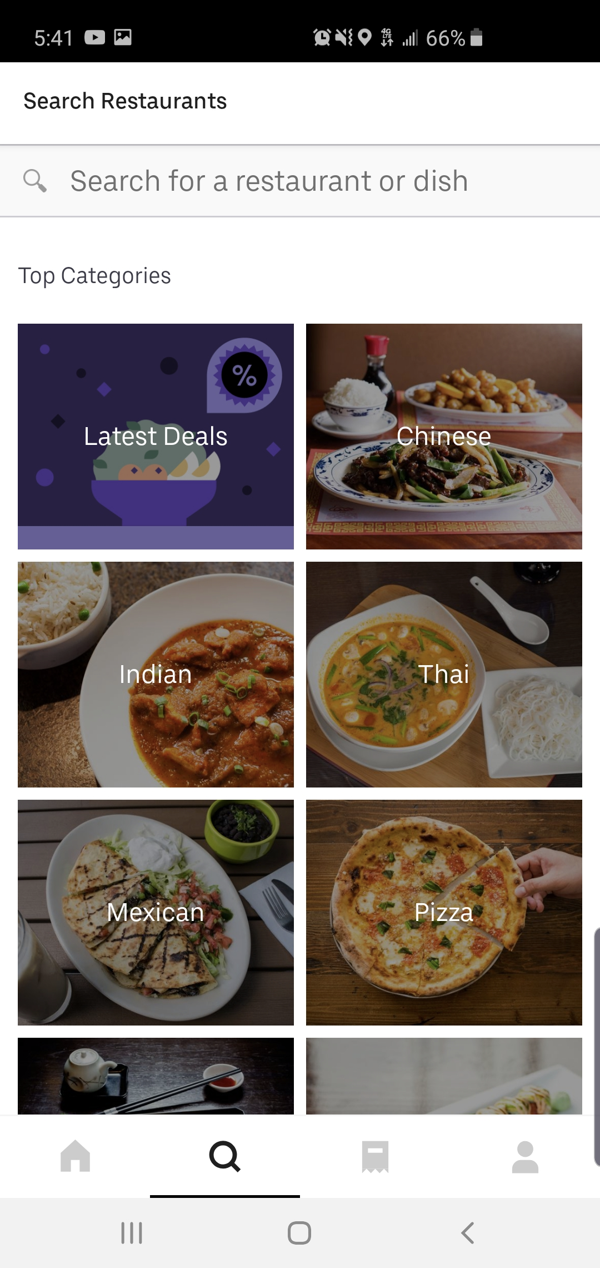
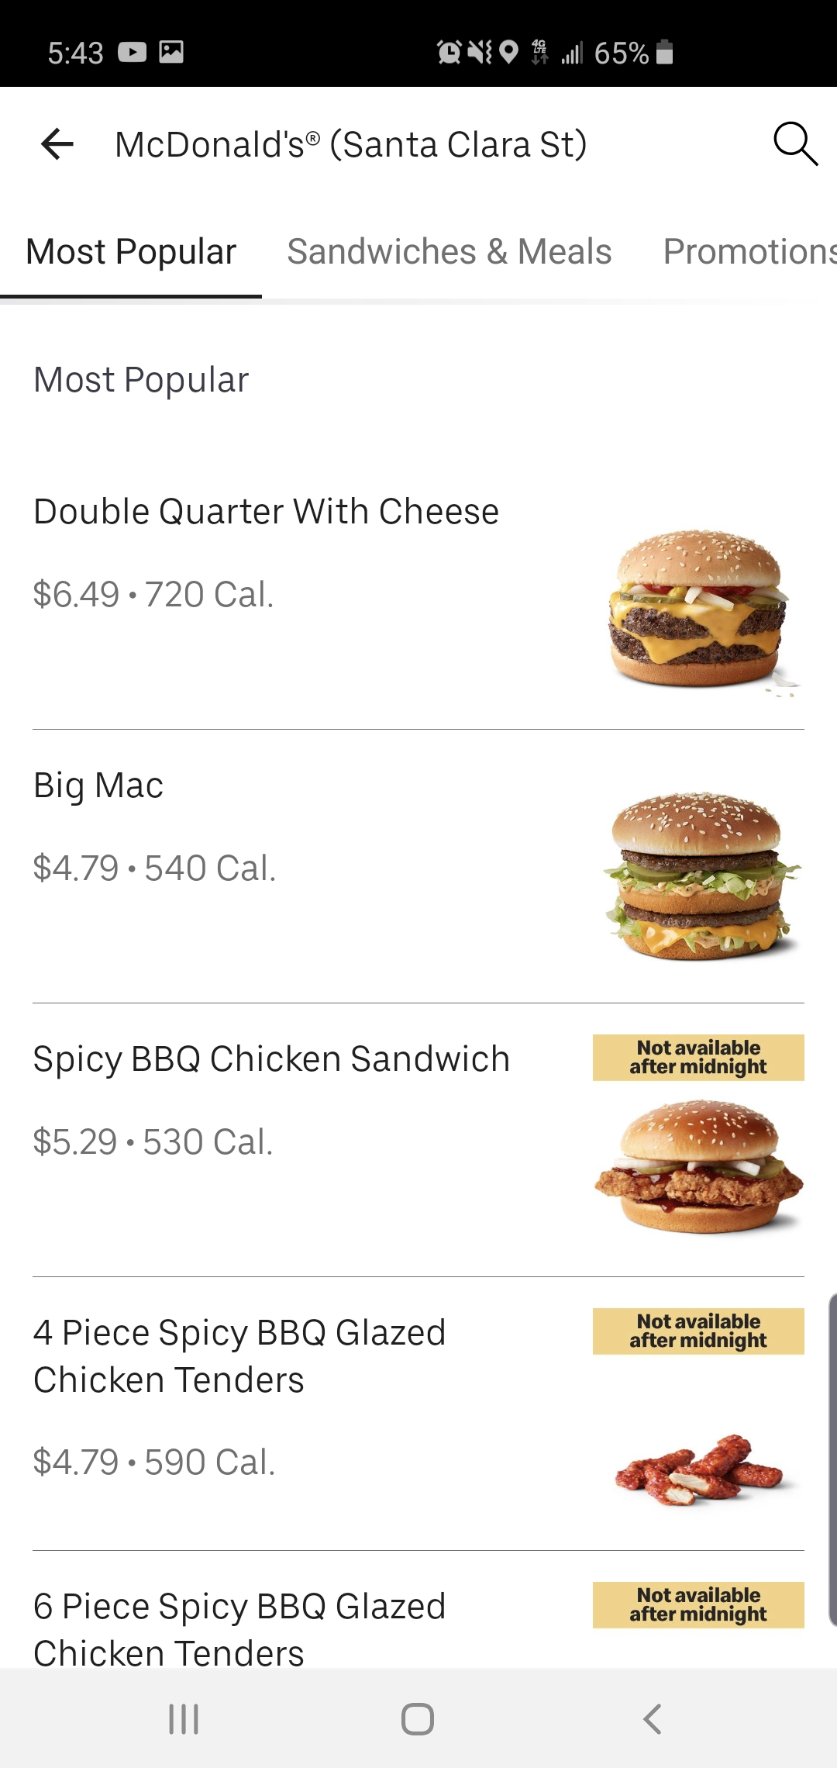
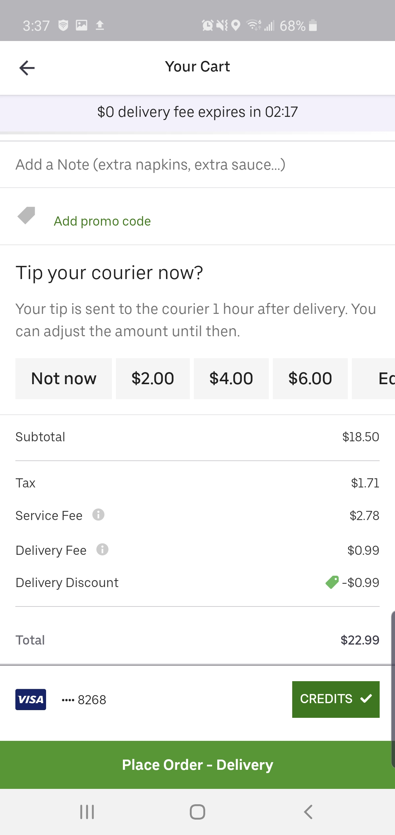

Slide 4
Feature Evaluation
Bad Assessment
Tabs and normal text are not distinguishable.
A lot of options in categories and items.
Option to update quantity, not well placed.
Changing delivery option not clear.
Option to remove item from cart should be on cart screen.
Out of context “Deliver with Uber” option in User screen.
Inconsistency in buttons.
Redundancy- same items in many lists.

Slide 5
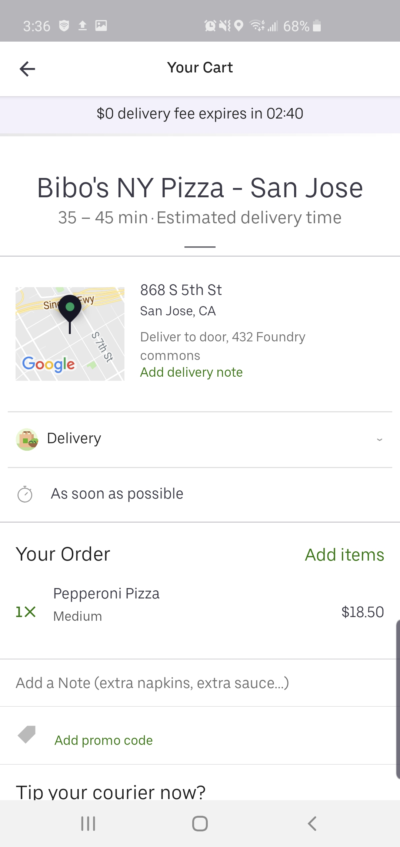
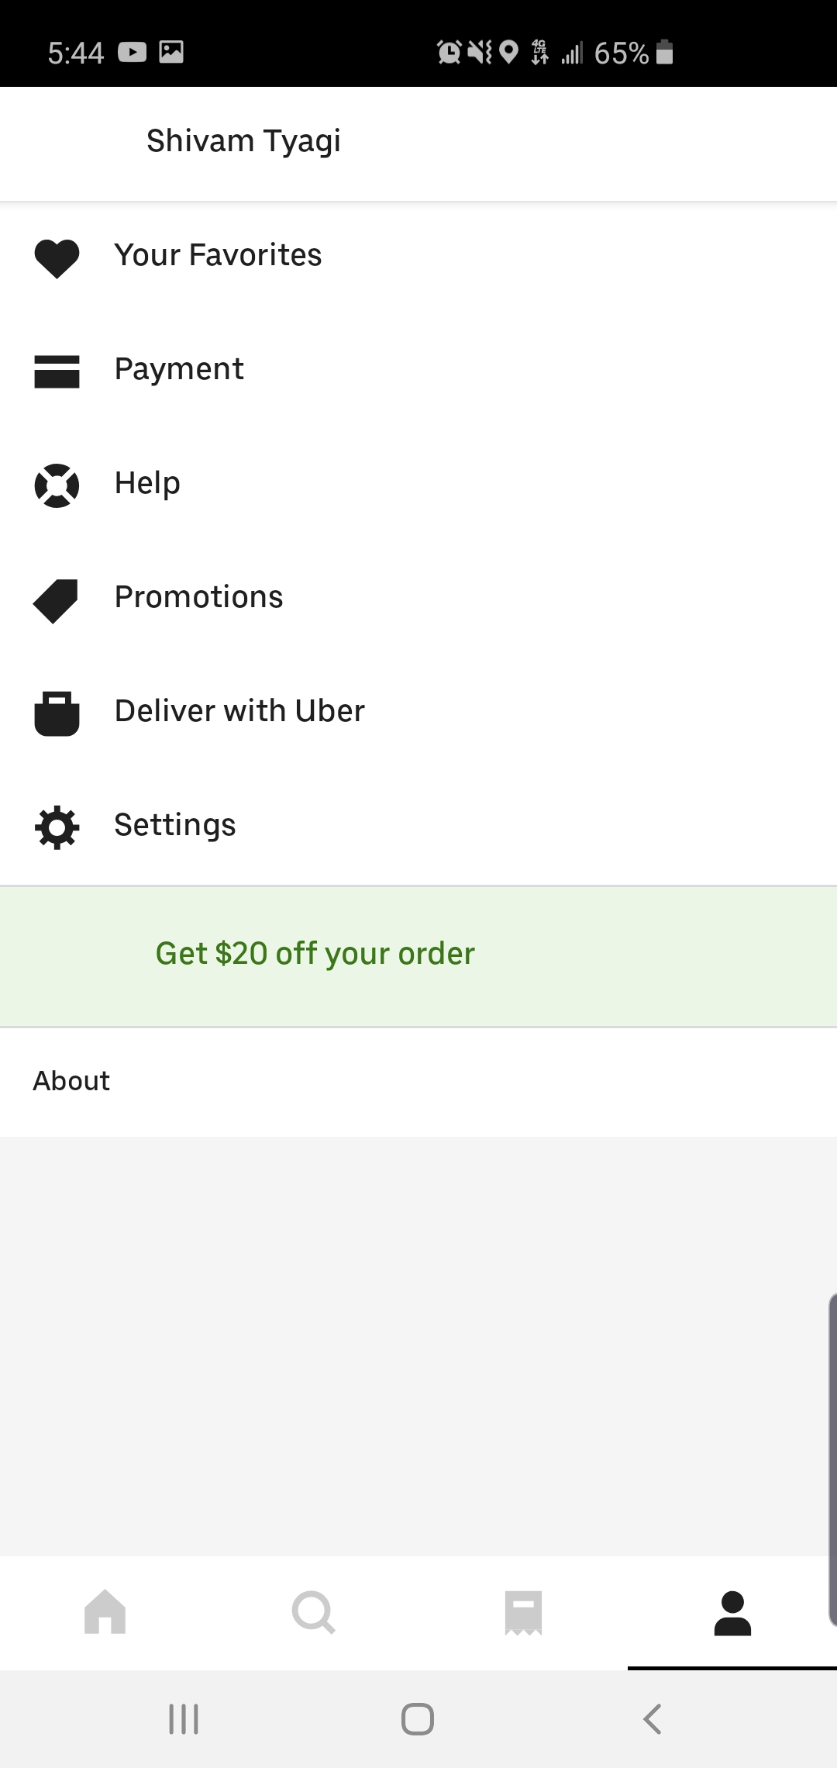
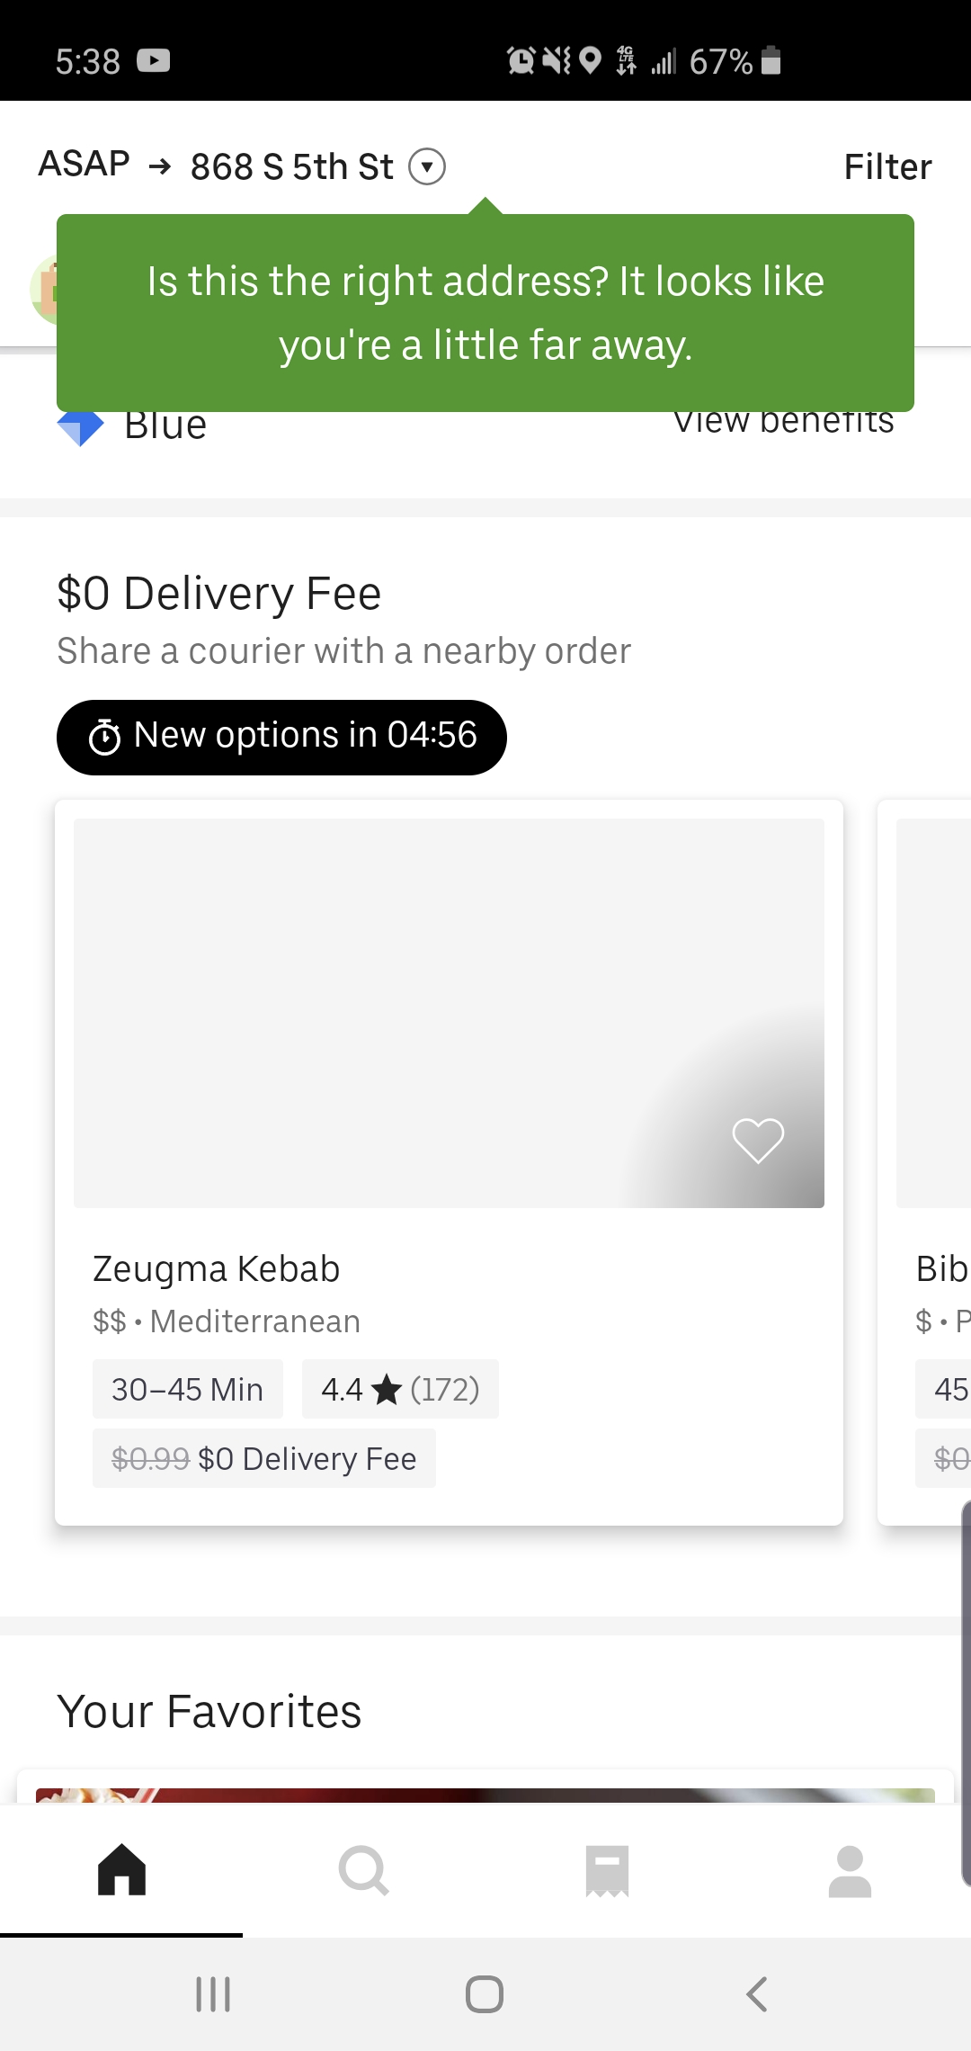
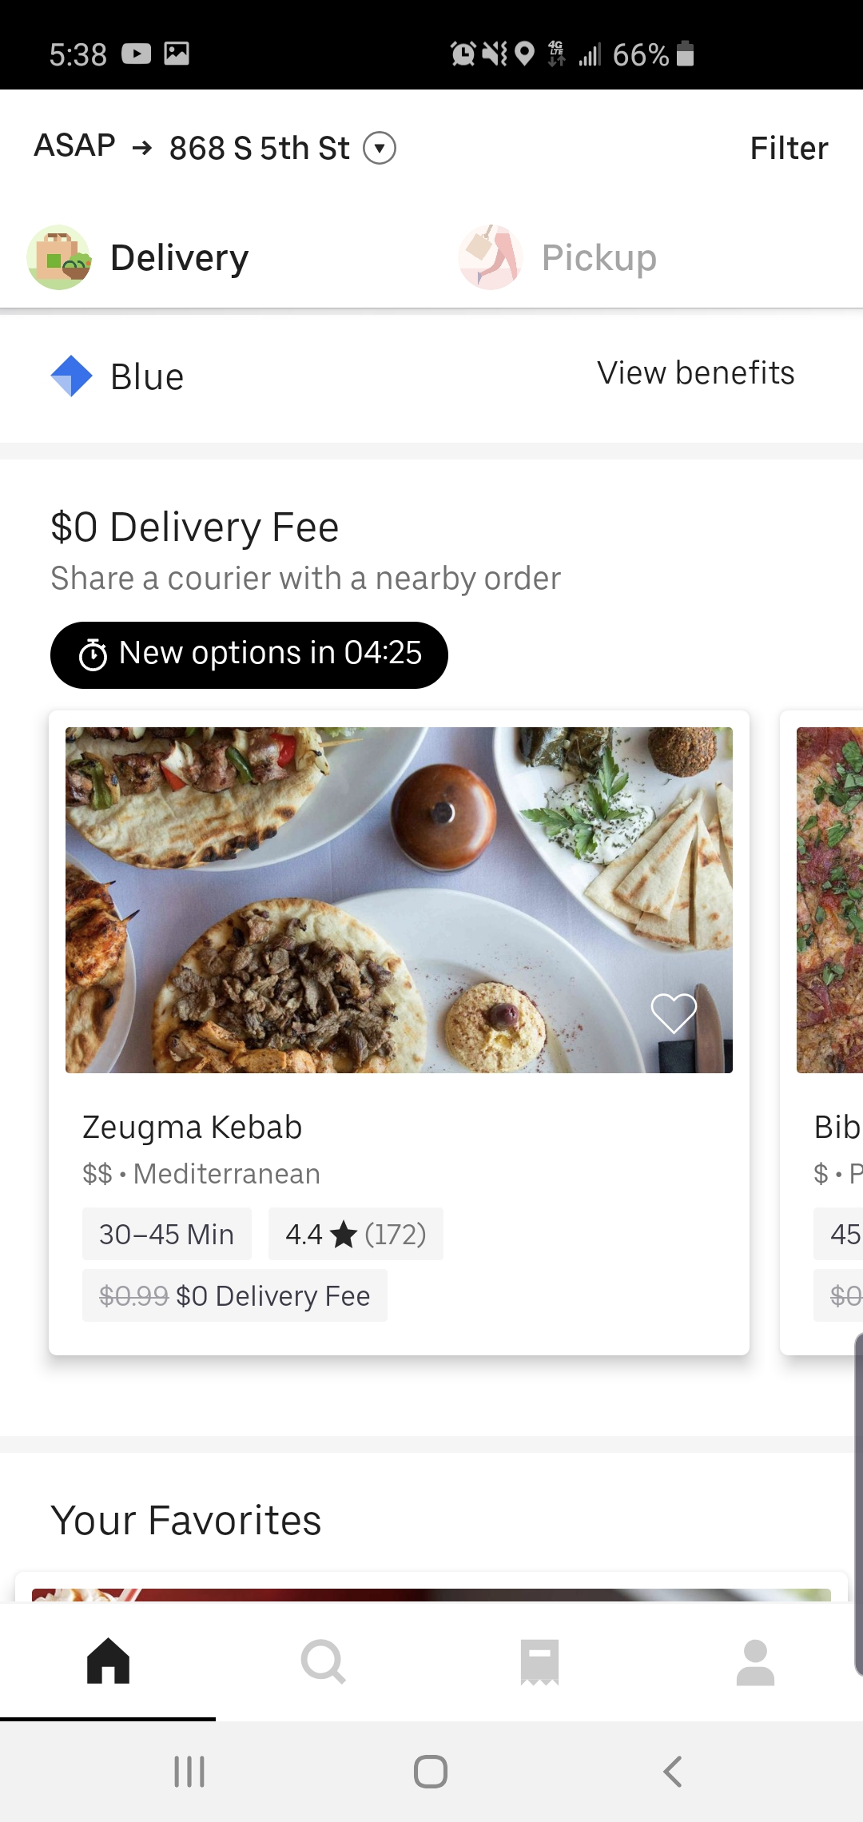
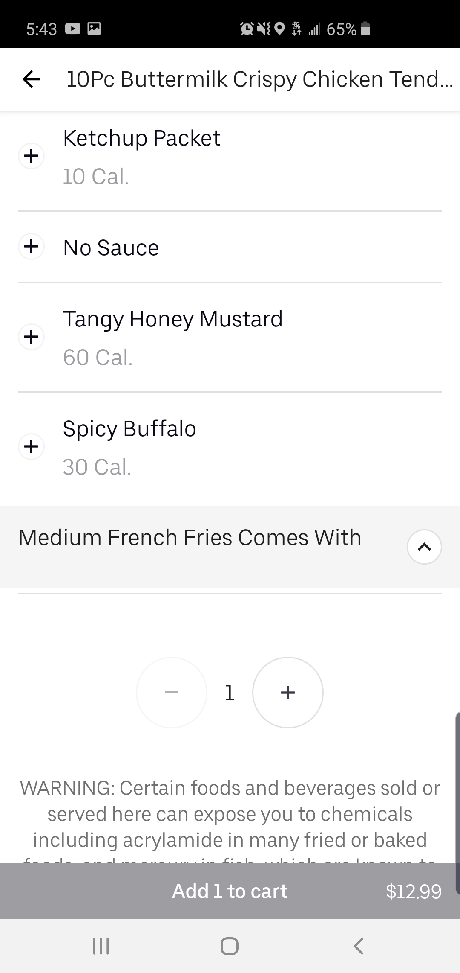

Slide 6
Analysis
Hick Law
Gestalt Principle
Simon Effect
Affordable Concepts
Discoverable Concepts
Focusing Attention
Golden Rules
Fitt's Law
George Miller Magic Number

Slide 7
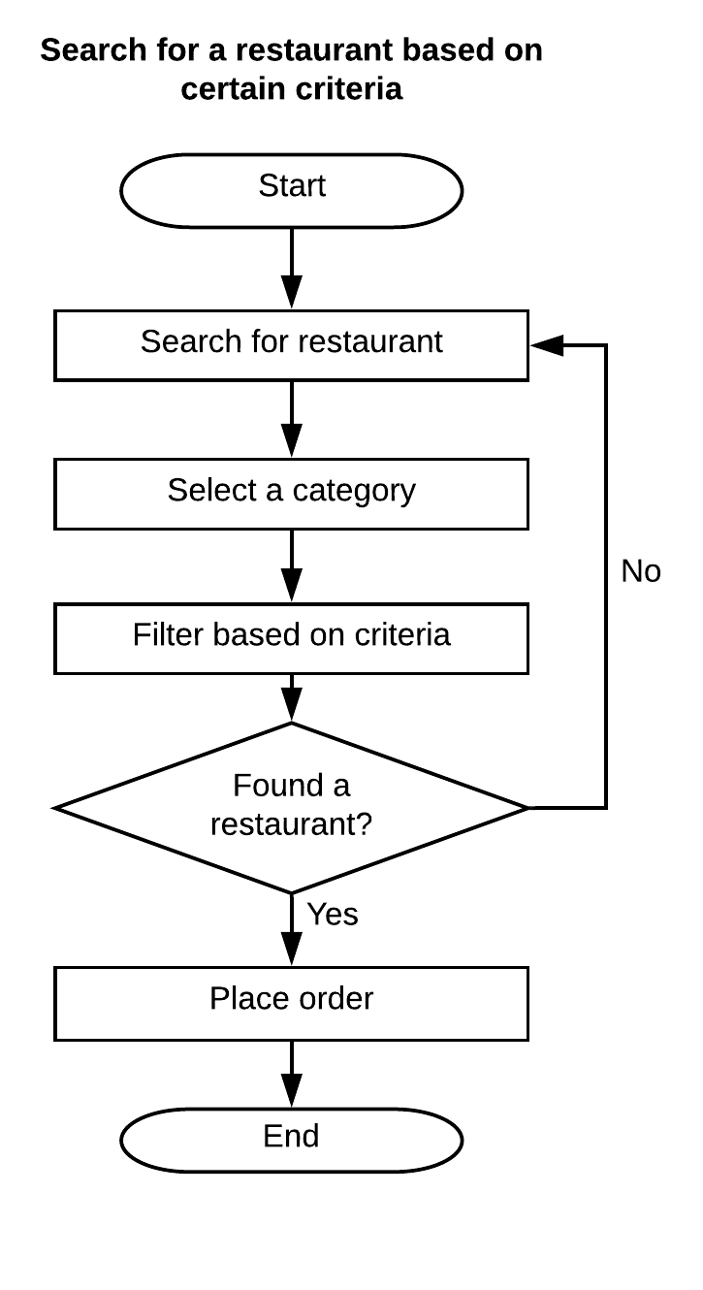
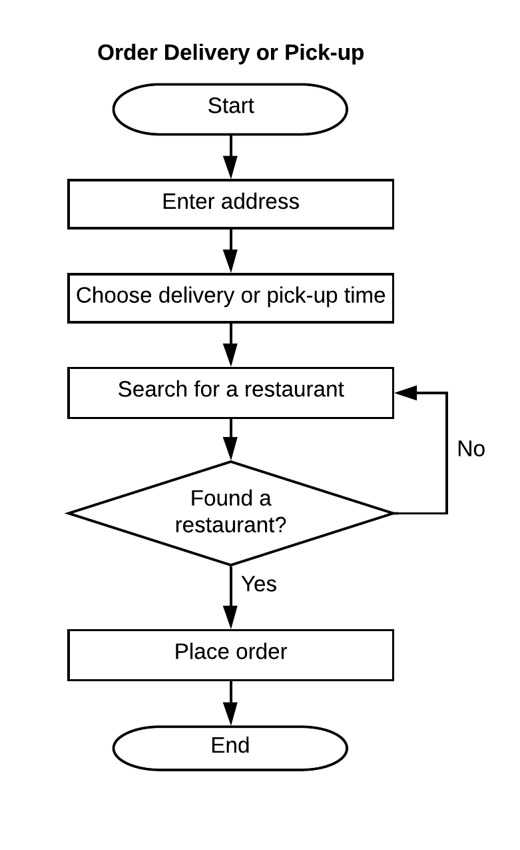
Task evaluation
Task 1: Using search to order food
Figure: Flowchart for using search to order food
Task 2: Order delivery or pick-up
Figure: Flowchart for order delivery or pick-up

Slide 8
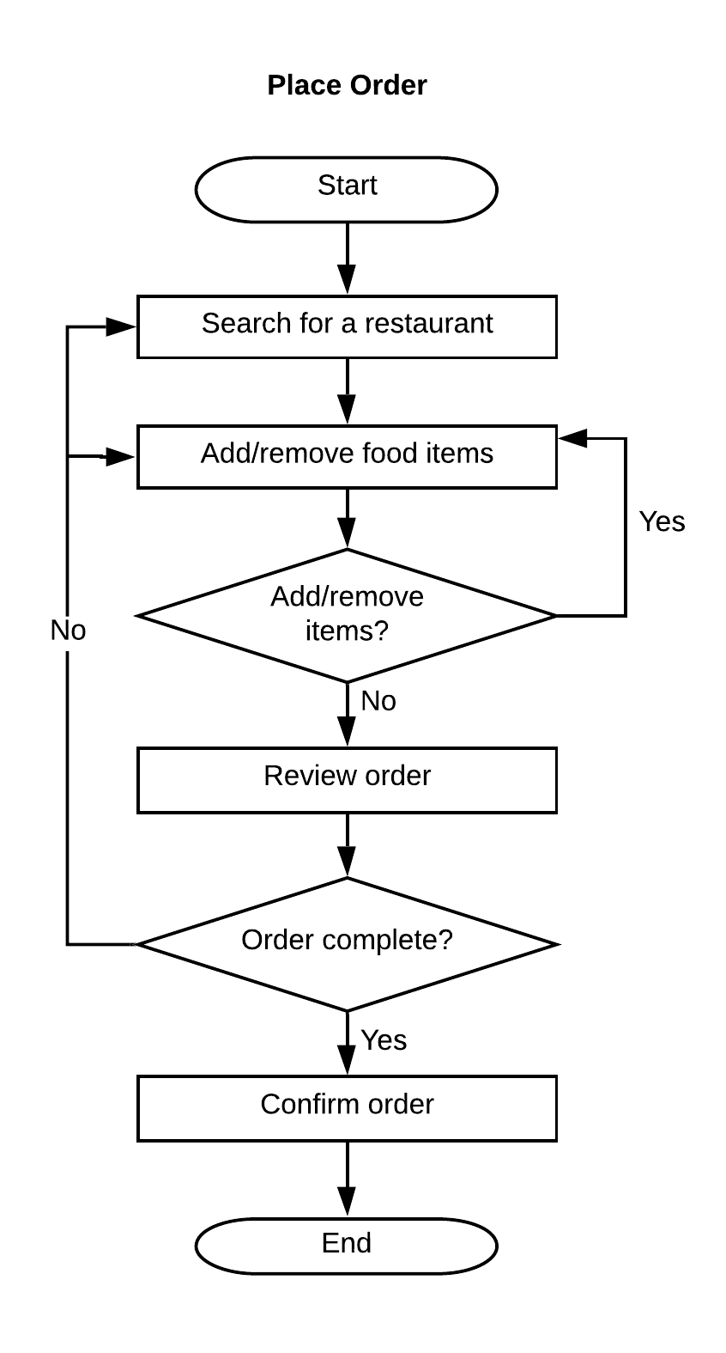
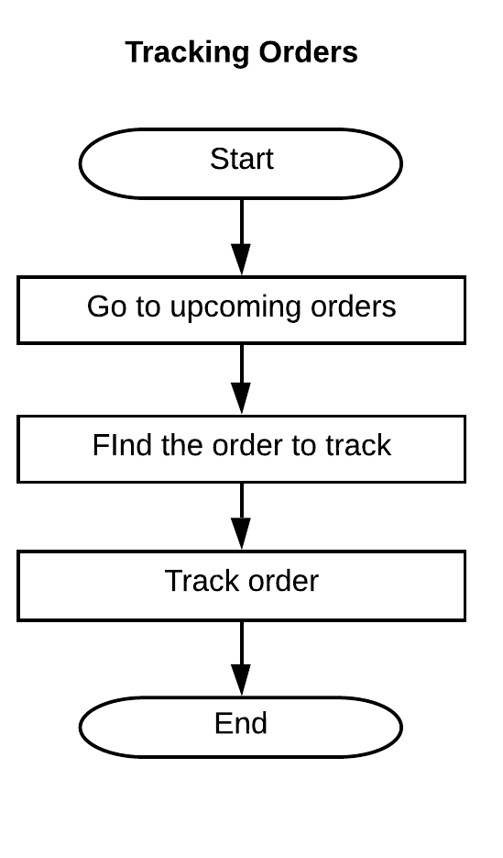
Task evaluation
Task 3: Place order
Figure: Flowchart for placing order
Task 4: Track order
Figure: Flowchart for tracking orders

Slide 9
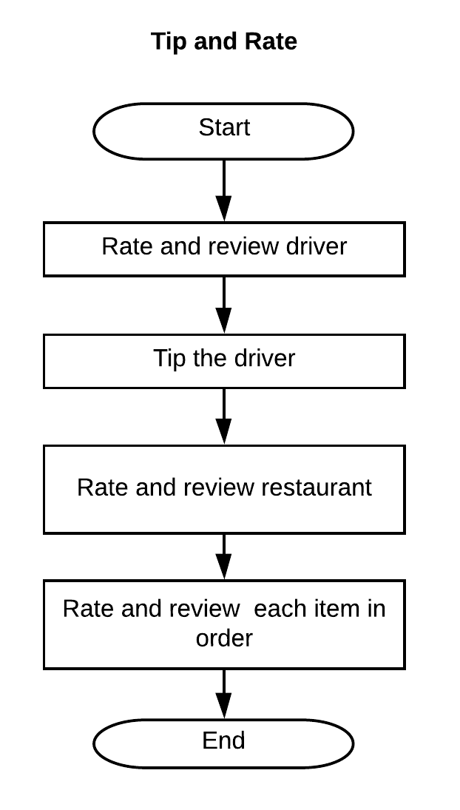
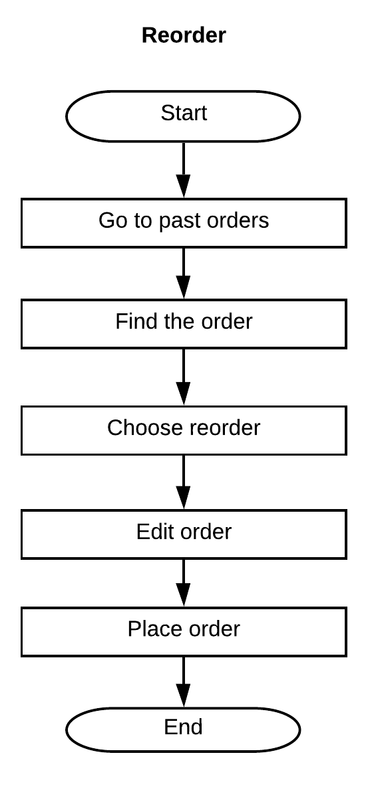
Task evaluation
Task 5: Tip and rate
Figure: Flowchart for tipping and rating
Task 6: Reorder
Figure: Flowchart for reordering

Slide 10
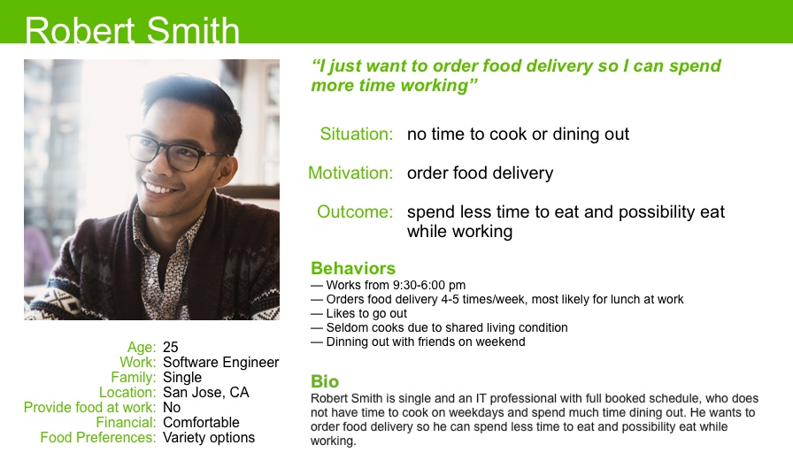
User Profiling
Persona 1 - Robert smith

Slide 11
Persona 1 - Robert smith
“I am hungry but I don't want waiting the long line”
“I want to order a fast food delivery. It is quick and I can save time to preparing the 2pm meeting”
“It is so convenient”
“It is not the best food but fast”
Now 12:30pm. Meeting at 2pm. long line at company cafeteria.
Open the uber eat app.
Enter location - lobby of the building
Choose a restaurant - fast food
Notification - Open the app tips and rate
Received food and enjoy
Receive the notification - the food is close
Enter deliver time - ASAP
“Tips and rate just in few clicks. It is easy!”
“Similar food at cafeteria but no waiting”
“I am getting ready to the lobby”
“Cool, the food is coming in 10-20 minutes”

Slide 12
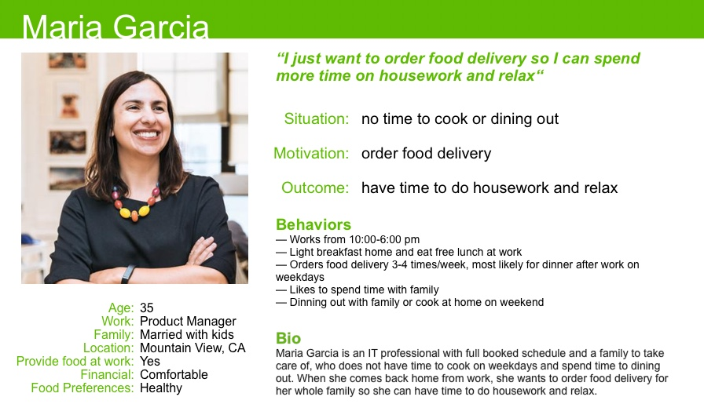
Persona 2 - Maria Garcia

Slide 13
Persona 2 - Maria Garcia
“I am ready to pick up my lovely kids and no time to cook”
“By the time I get back home food is ready for my whole family ”
“I will be at house in an hour”
“My family need healthy food”
Now 6pm. Just off work.
Open the uber eat app.
Enter location - my house
Choose a restaurant - healthy food
Notification - Open the app tips and rate
Received food and family enjoy
Receive the notification - the food is close
Enter deliver time - 8:30pm
“Tips and rate just in few clicks. It is easy!”
“Delivery to door it is convenient”
“I am cleaning the table and let family ready for the food coming”
“I need schedule a delay food delivery”

Slide 14
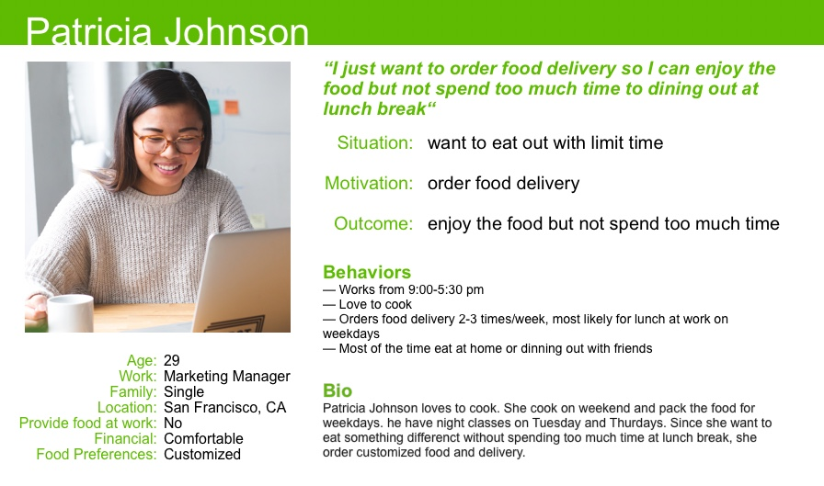
Persona 3 - Patricia Johnson

Slide 15
Persona 3 - Patricia Johnson
“I want to eat something different and delicious without waiting in the line”
“Nice! There are few new opening restaurants arounds”
“I can eat at park with nice breeze just outside of building”
“I love to experience something new”
Now 12. Lunch break starts.
Open the uber eat app.
Enter location - front door of the building
Choose a restaurant - fancy one
Notification - Open the app tips and rate
Received food and enjoy
Receive the notification - the food is close
Enter deliver time - ASAP
“Tips and rate just in few clicks. It is easy!”
“I saved up a lot time at lunch break”
“I am ready for the nice weather and food”
“The food is coming in 30-45 minutes, it is not too bad”

Slide 16
Usability Metrics for Product Evaluation
Quantitative metrics
Success rate
Task duration
Number of system generated errors or crashes
Qualitative metrics based on Jakob Nielsen’s usability heuristics
Feedback or visibility of system status
Use of user’s language
User control and freedom
Consistency and standards
Error prevention
Recognition rather than recall
Flexibility and efficiency of use
Aesthetic and minimalist design
Error messages and error recovery
Help and documentation

Slide 17
Product Evaluation Using Usability Metrics
Quantitative metrics
10 people were asked to place orders
Success rate - 100%
Task duration to place orders
3 users spent two minutes approximately
4 users spent between 4 and 6 minutes.
3 users spent between 8 and 10 minutes to place their order
3 users faced technical difficulties during the task

Slide 18
Product Evaluation Using Usability Metrics
Qualitative metrics based on Jakob Nielsen’s usability heuristics
Feedback or visibility of system status
Use of user’s language
User control and freedom
Consistency and standards
Error prevention
Recognition rather than recall
Flexibility and efficiency of use
Aesthetic and minimalist design
Error messages and error recovery
Help and documentation

Slide 19
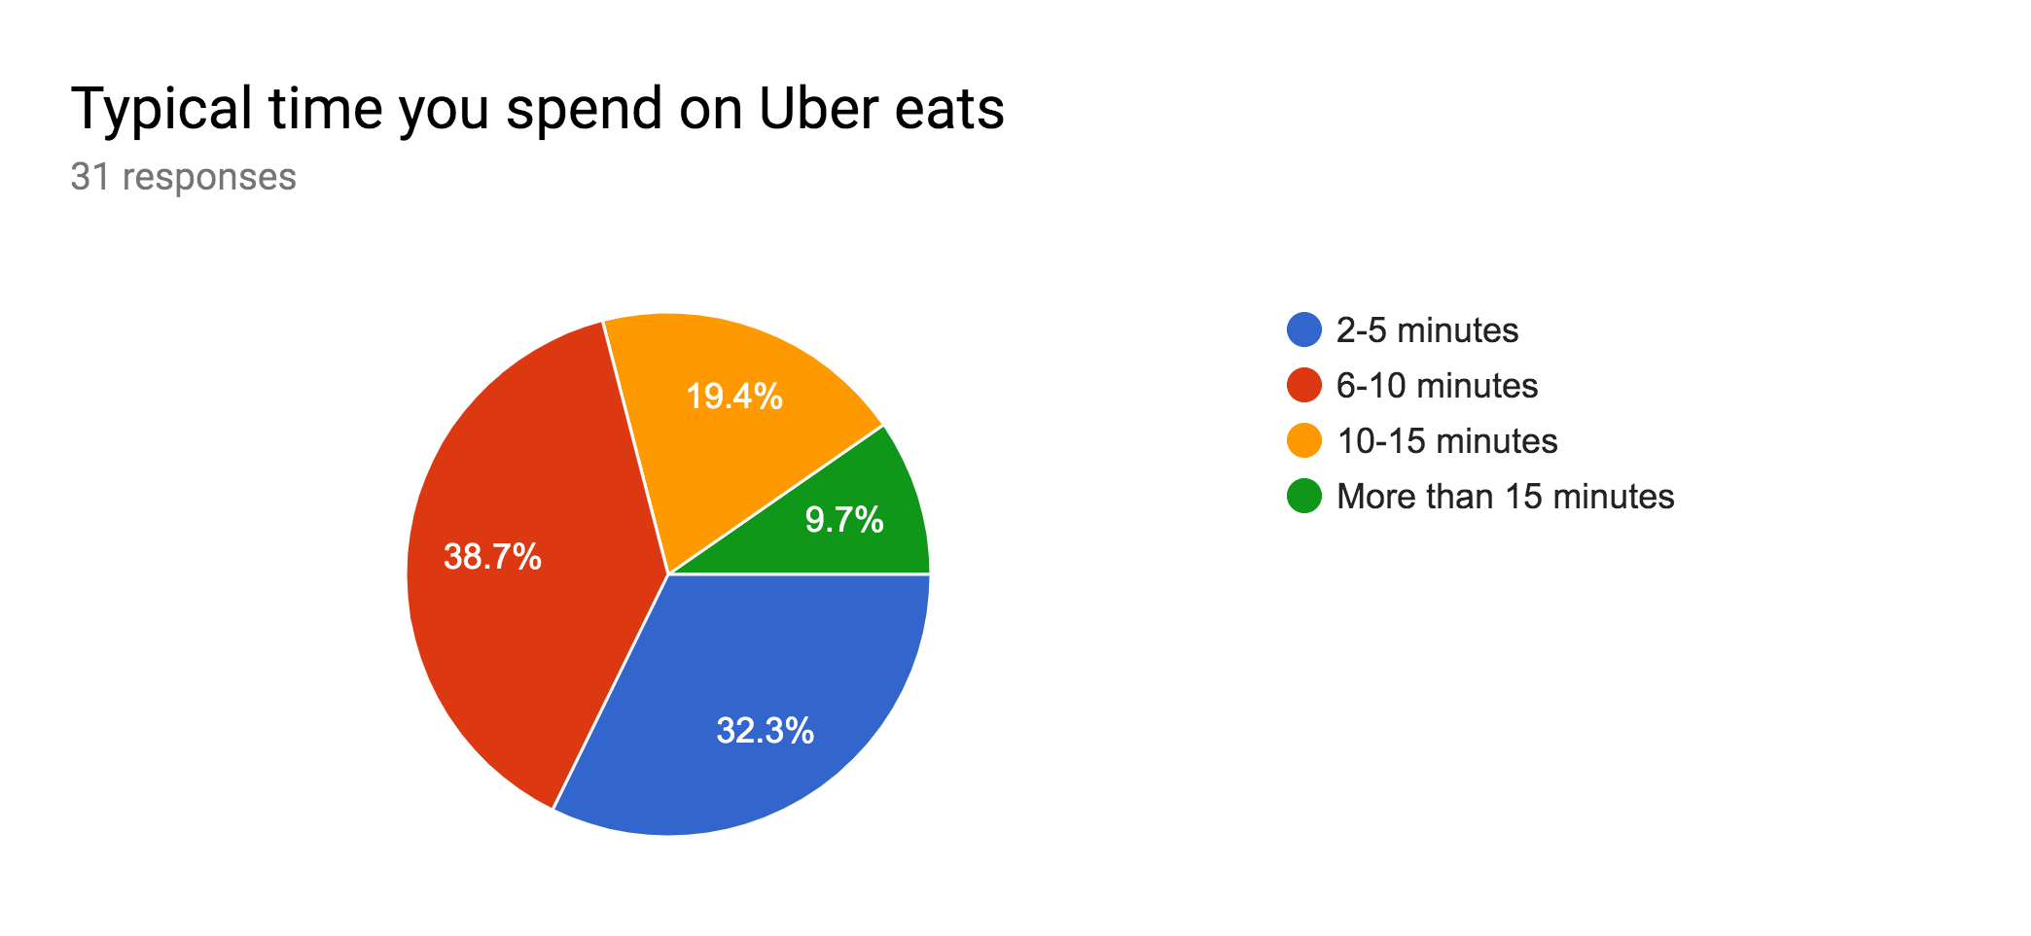
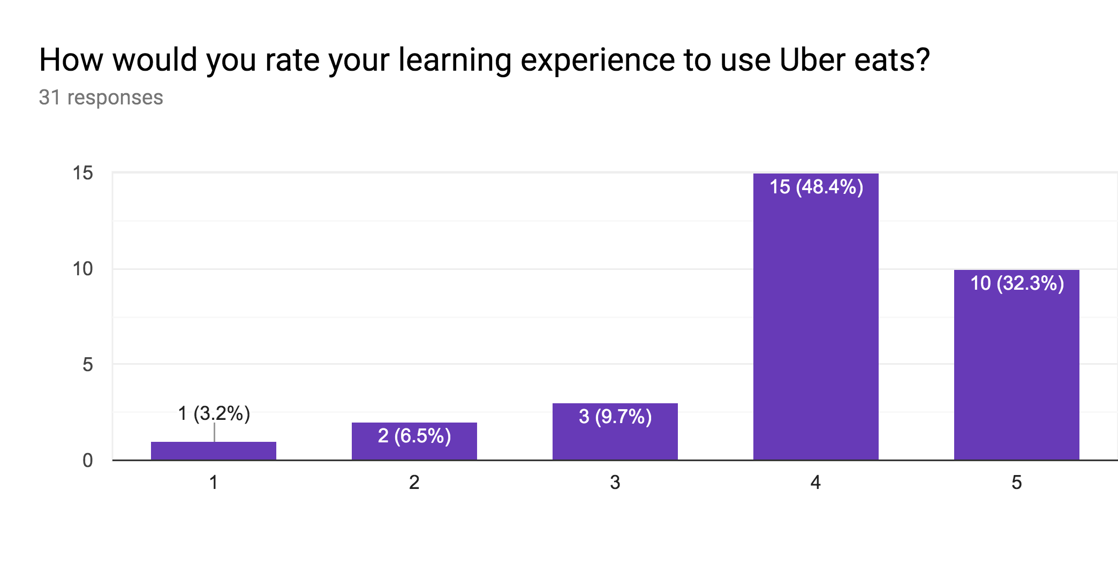
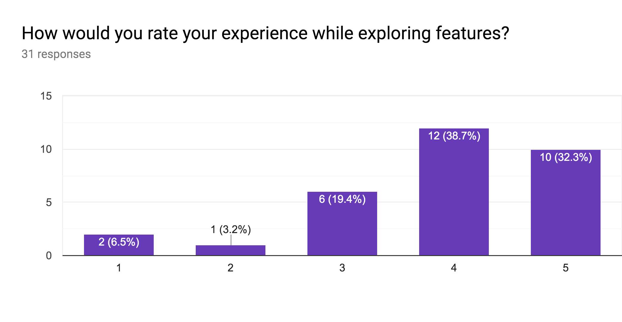
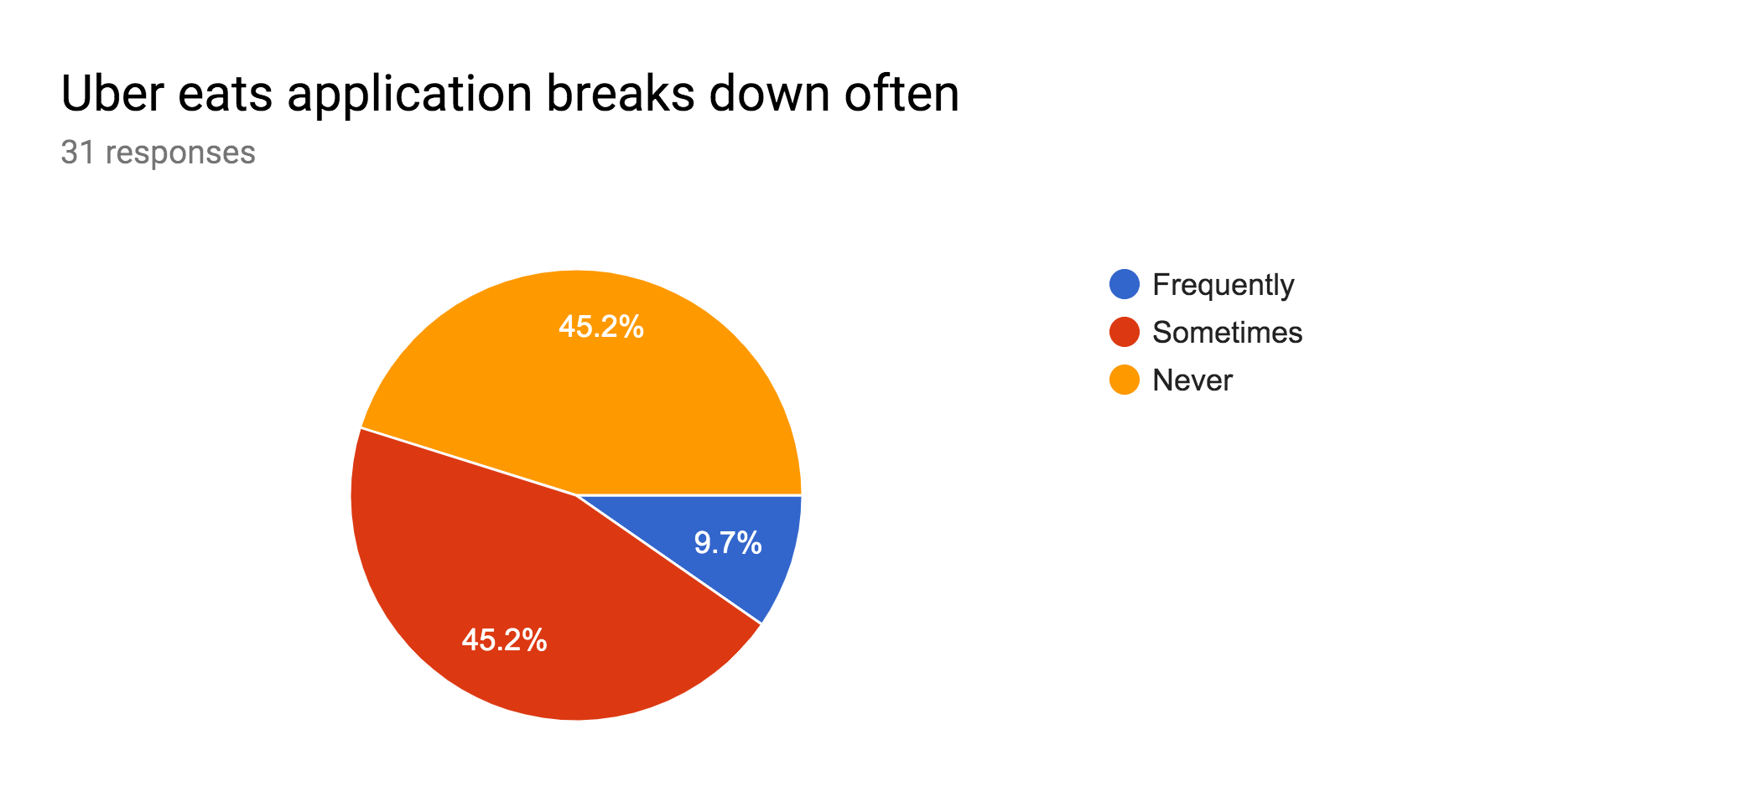
User Usability Experience Survey Results of 31 people

Slide 20
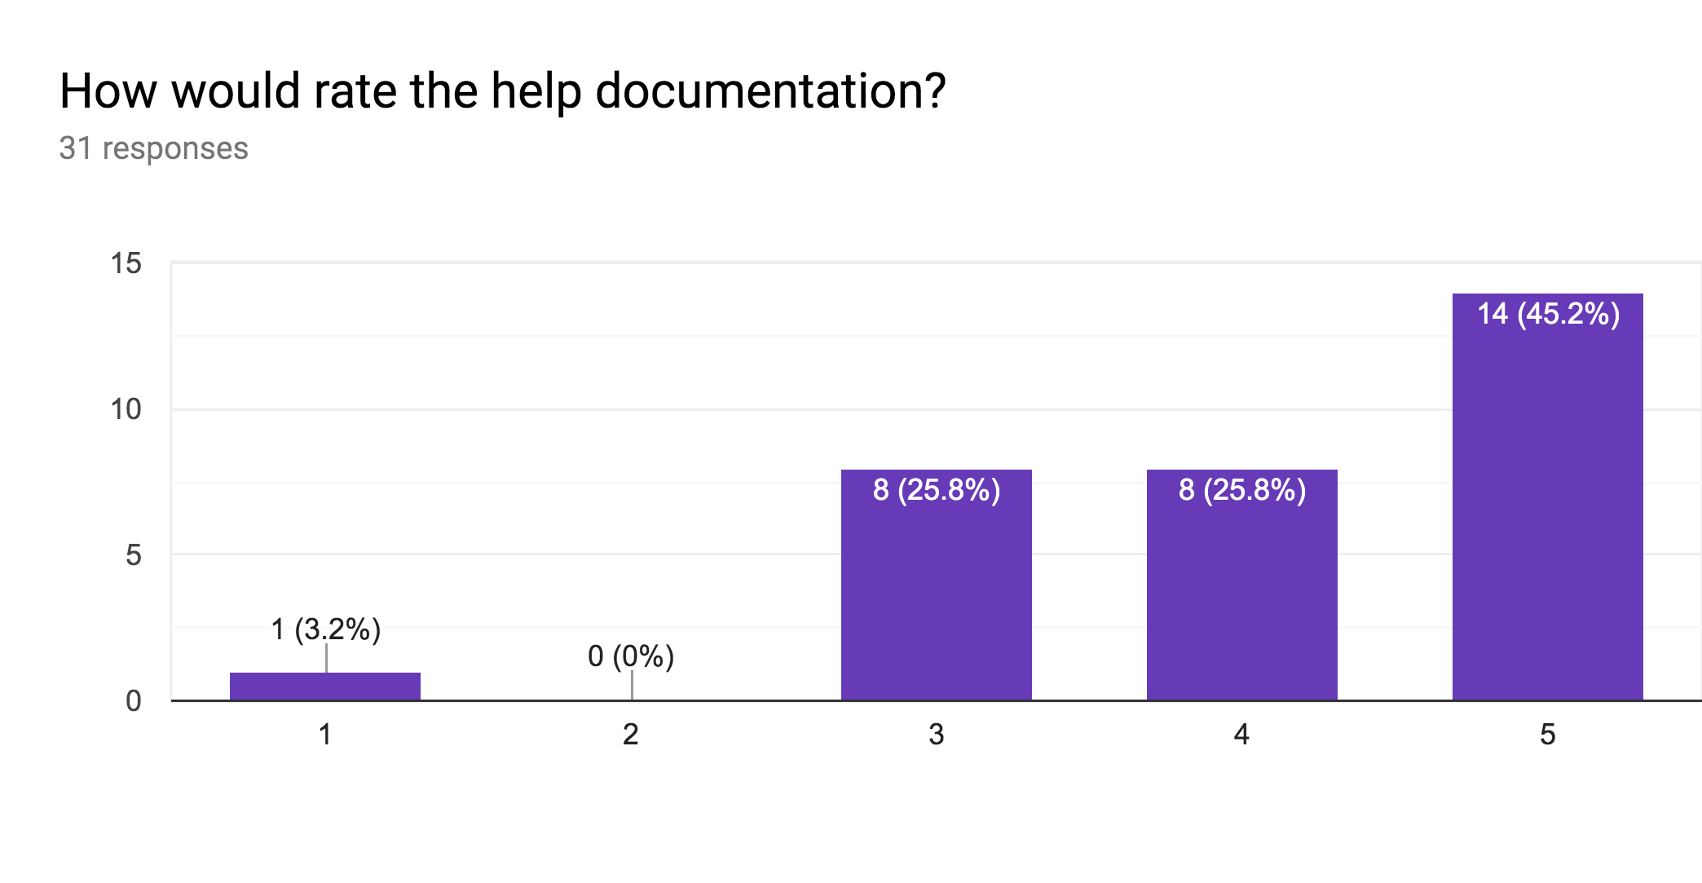
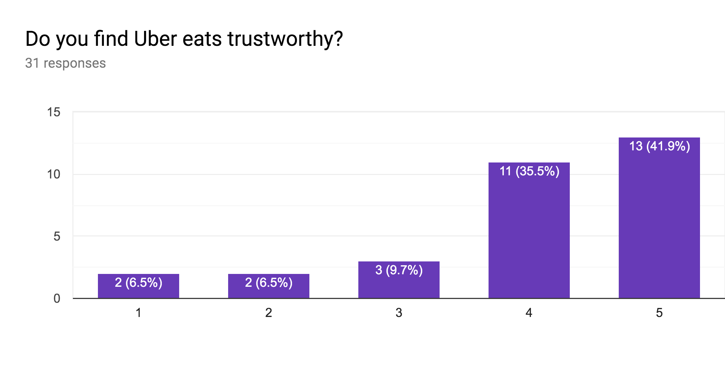
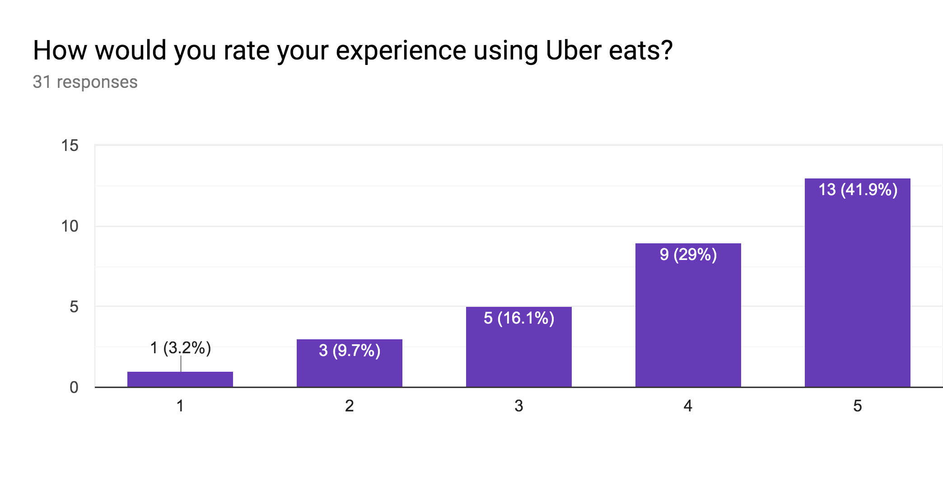
User Usability Experience Survey Results of 31 people

Slide 21
Comparative Study
Compared UberEats with other food delivery apps in the market on the basis of following parameters:
Availability in different locations
Customer support
Delivery Charges
Subscription Service
Other services provided

Slide 22
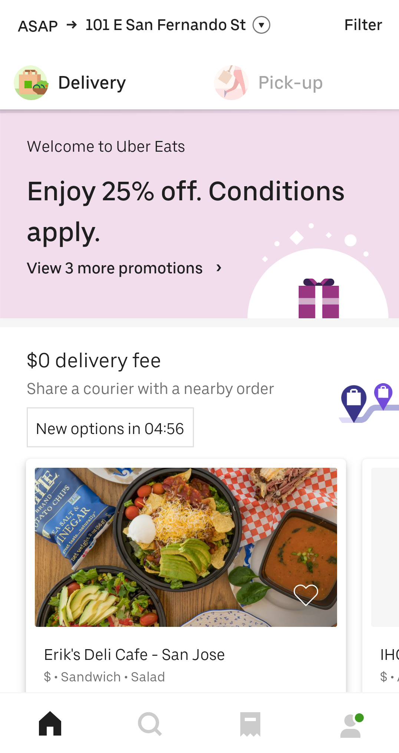
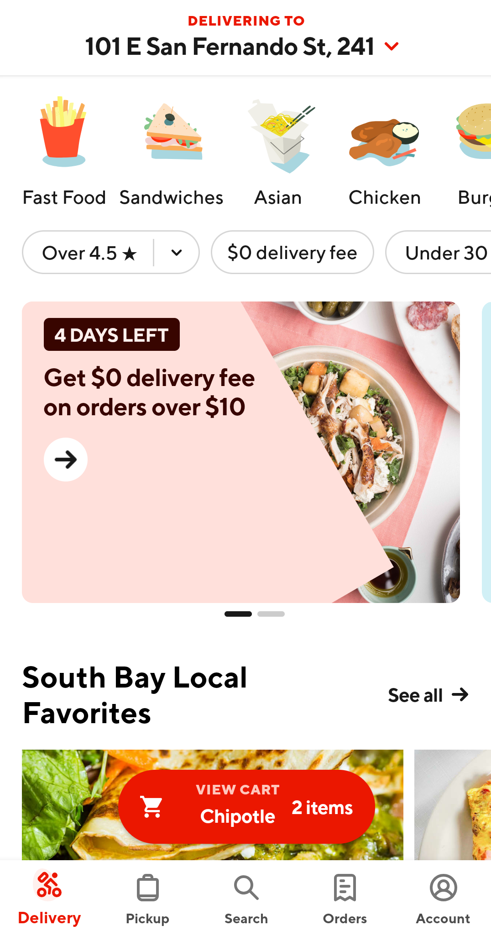
Comparative Study
UberEats DoorDash

Slide 23
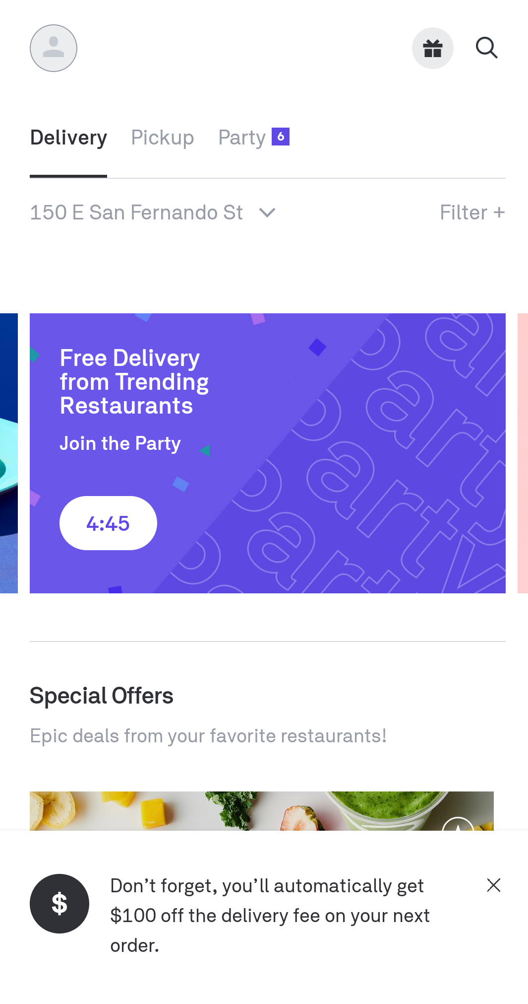
Comparative Study
UberEats Postmates

Slide 24
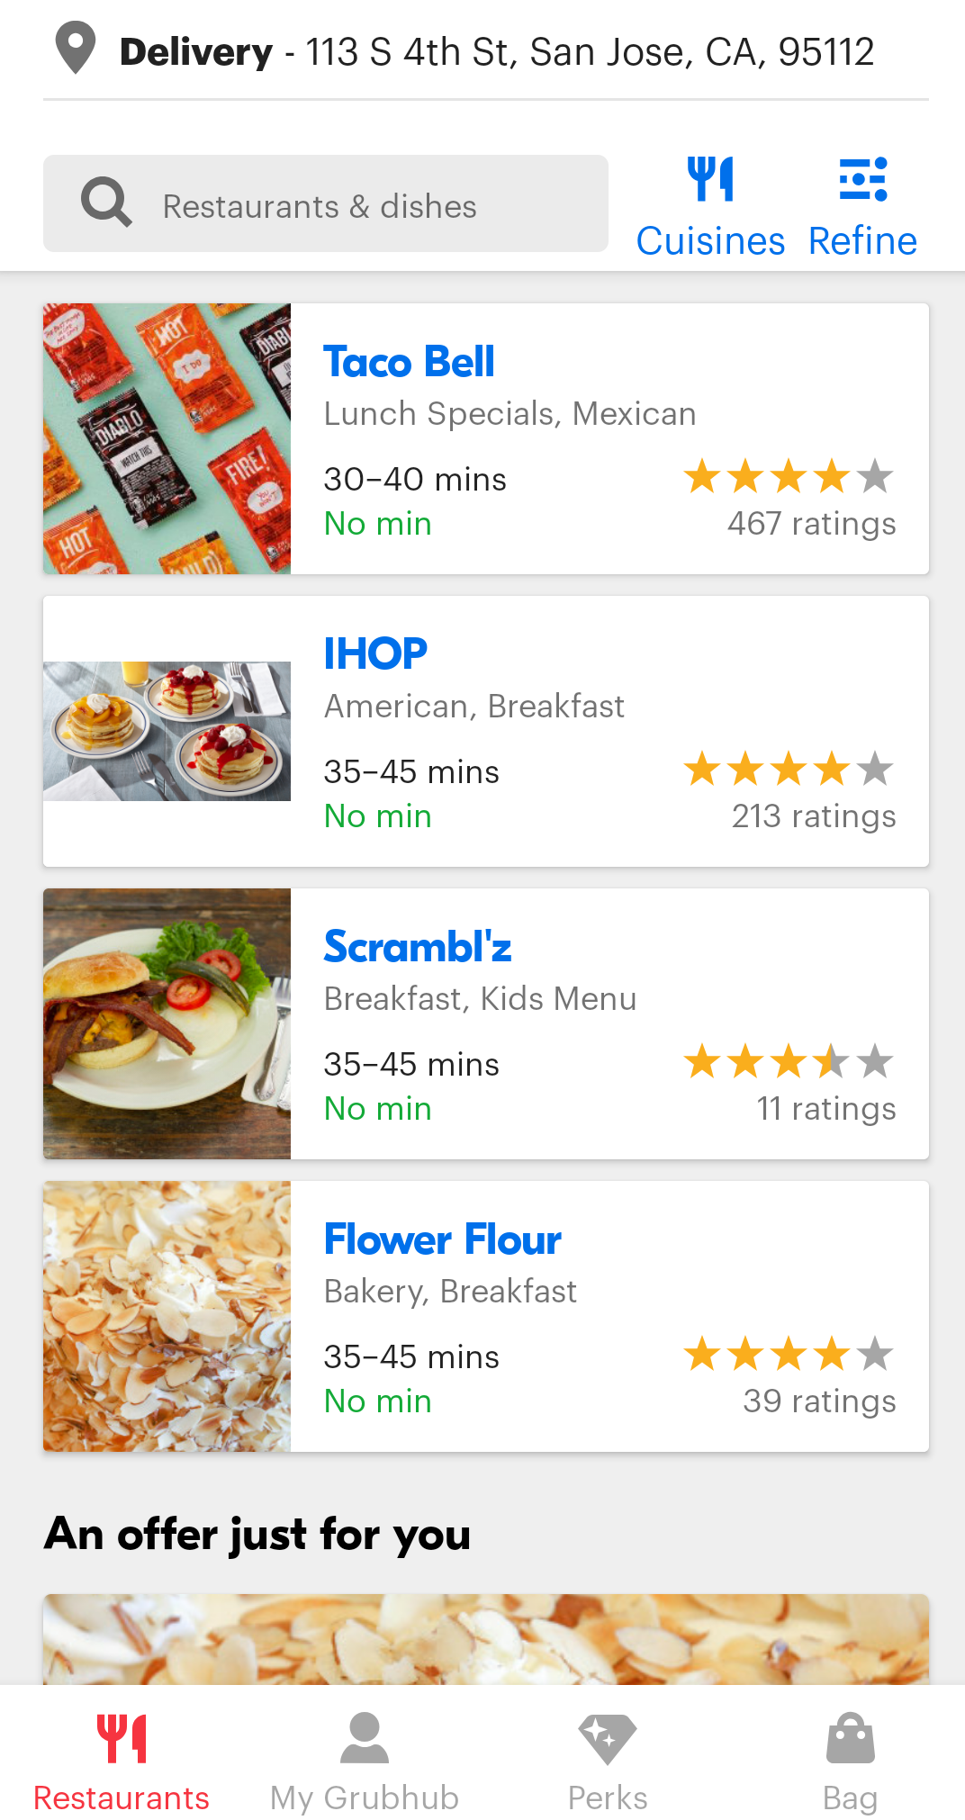
Comparative Study
UberEats Grubhub

Slide 25
Tools
Tools used for performing various tasks:
UberEats app
Google Forms
Pingdom
Sketch
Lucidchart
Adobe Photoshop

Slide 26
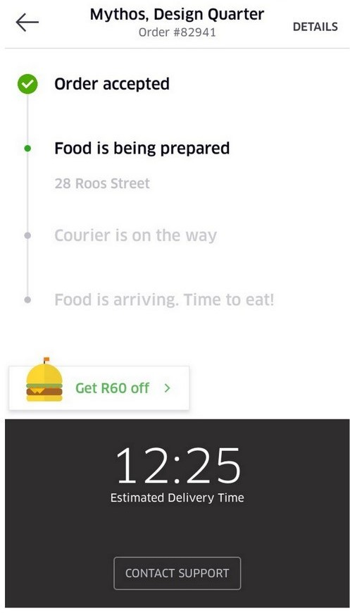
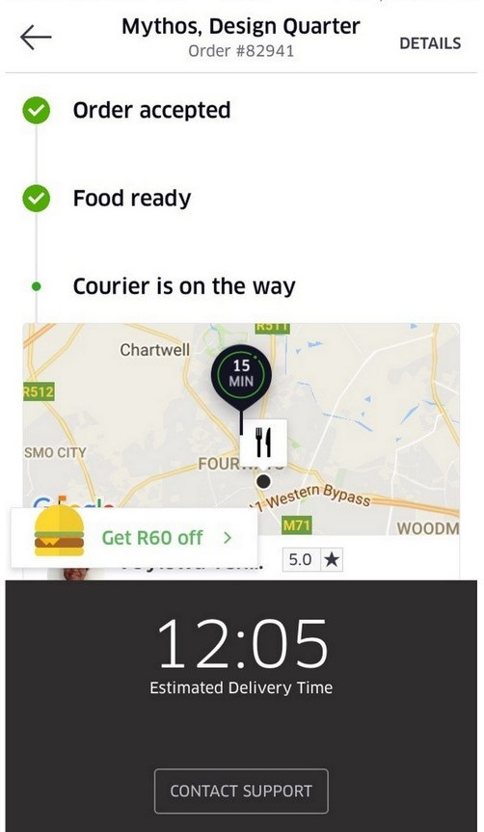
Techniques
Technique used for usability testing:
Selected task : To track the order after placing the order.
Easy to use, live order tracking.

Slide 27
Suggested Interface Enhancements
Merge Home and Search Screen
Add add/remove quantity option in Cart screen
Grouping “Deliver with Uber” option differently.
Making clickable tabs distinctly visible.
Making Delivery change time option more visible.
Minimising redundancy.
Automatic/having an option to switch to viewing in text alone in poor internet environment
Showing the right user stage on the screen

Slide 28
Conclusion
One of the best food delivery apps in the market
Overall user friendly
Still Need improvements

